Slide 1
AGILE METHODOLOGIES
Prepared By,
A.Kiruthika
Assistant Professor
Department.of CSE
Kongu Engineering College

Slide 2
AGILE METHODOLOGIES
Course Outcomes
Unit – I Process Models, Analysis and Design
Apply the requirement engineering tasks, design concepts and analyze the various software development models for a given scenario
Unit - II Agile Principles and Scrum
Apply agile principles and apply Scrum for project development.
Unit - III XP and Incremental Design, Lean, and Kanban
Model applications using XP, Lean and Kanban practices.

Slide 3
22CSC51 - AGILE METHODOLOGIES
Course Outcomes
Unit - IV Software Testing Fundamentals
Make use of various software testing techniques to test the software systems.
Unit - V Software Project Management
Estimate the cost of software, risks of handling, do software planning and configuration management.

Slide 4
What is Software?
Software is:
(1) instructions (computer programs) that when executed provide desired features, function, and performance;
(2) data structures that enable the programs to adequately manipulate information and
(3) documentation that describes the operation and use of the programs.

Slide 5
Characteristics
Software is developed or engineered; it is not manufactured.
Software doesn’t “wear out.”
Although the industry is moving toward component-based construction, most software continues to be custom built.

Slide 6
Software Application Domains
System software—a collection of programs written to service other programs.
(e.g., compilers, editors, operating system components, drivers)
Application software—stand-alone programs that solve a specific business need.
e.g., word processing, spreadsheets,
Engineering/scientific software—has been characterized by “number crunching” algorithms.
Embedded software—resides within a product or system and is used to implement and control features and functions for the end user and for the system itself.
(e.g., digital functions in an automobile such as fuel
control, dashboard displays, and braking systems).

Slide 7
Software Application Domains
Product-line software—designed to provide a specific capability for use by many different customers.
(e.g., inventory control products) or address mass
consumer markets)
Web applications—called “WebApps,” this network-centric software category spans a wide array of applications.
Artificial intelligence software
Applications within this area include robotics, expert systems,
pattern recognition (image and voice), artificial neural networks, theorem proving, and game playing.

Slide 8
Software Engineering
Software engineering is the establishment and use of sound engineering principles in order to obtain economically software that is reliable and works efficiently on real machines.
The IEEE Definition:
Software Engineering is defined as the application of a systematic, disciplined, quantifiable approach to the development, operation, and maintenance of software; that is, the application of engineering to software.

Slide 10
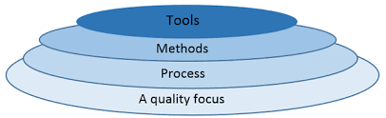
Software Engineering Layers
The Process is the foundation.
Methods and tools cannot work effectively without it.

Slide 11
Layer 1 – Quality Focus
Suppose
Library Management System.
Student clicks
Issue Book
Software crashes.
Is software good?
No.
Therefore,
Coding ≠ Quality.

Slide 12
Quality?
No bugs alone is not quality.
Quality also includes
Performance
Security
Reliability
Customer Satisfaction

Slide 13
Layer 2 – Process
SupposeFive developers.Each starts coding independently.
Developer 1 Login
Developer 2 Database
Developer 3 Payment
Developer 4 Testing
Developer 5 UI
Nobody communicates.
Will project succeed?

Slide 14
PROCESS?
Process means
A systematic sequence of activities followed to develop software.
It answers
WHAT should happen first?
WHAT should happen next?
WHAT to do?
REQ→PLAN→DESIGN→CODING→TEST→DEPLOY→FEEDBACK
Process is Foundation
Without process
→Confusion
→Delay
→Bugs
→Customer dissatisfaction

Slide 15
Layer 3 – Methods
Methods are
Technical techniques used to perform development activities.
Methods answer
HOW should we do the work?
Requirement Gathering
↓
Interview
Questionnaire
Brainstorming
Design
↓
UML
Class Diagram

Slide 16
Layer 4 – Tools
Can developers write code without software?
Coding → VS Code
GitHub → Version Control
Draw.io → UML
JUnit → Testing
MySQL Workbench→Database
Can developers write code without software?
Developers use software to develop software.

Slide 17
"Which layer is most important?"
Quality is the overall goal.
Process is the foundation.
Methods define how work is performed.
Tools support the methods.
All four are necessary.

Slide 18
"Why is Process above Methods?"
Because Process decides what activities happen.
Methods explain how each activity is carried out.
Without deciding the activity, you cannot choose an appropriate method.

Slide 19
Software Process and Process Model
Software process
Is a framework for the activities, actions, and tasks that are required to build high quality software.
A process Models
Describe the sequence of phases for the entire lifetime of a product. It is also known as Product Life Cycle.

Slide 20
Activities-Major phases.
Communication
Planning
Modeling
Construction
Deployment

Slide 21
Example (Library Management System)
Suppose the college wants software with the following features:
Student Login
Search Books
Issue Books
Return Books
Fine Calculation
To develop this software, we perform these activities:

Slide 22
To develop this software, we perform these activities:
Activity 1: Communication
Meet the librarian and understand requirements.
Activity 2: Planning
Estimate cost, duration, and team members.
Activity 3: Modeling
Prepare database design, UML diagrams, and screen layouts.
Activity 4: Construction
Write code and test the software.
Activity 5: Deployment
Install the software in the college library and train the staff.
These five are Activities.

Slide 23
What is an Action?
Is Communication completed by simply meeting the librarian once?
Communication itself consists of several smaller pieces of work.
These are called Actions.
An Action is a subdivision of an Activity.
One activity can contain many actions.

Slide 24
Each one is an Action.
Requirement Gathering
Collect all the requirements from the librarian.
Requirement Analysis
Check whether the collected requirements are complete and practical.
Requirement Validation
Confirm with the librarian that the requirements are correct.
These are all Actions inside the Communication activity.

Slide 25
What is a Task?
"Can Requirement Gathering be completed in one step?“
A Task is the smallest unit of work performed to complete an action.
Tasks are assigned to individual developers or team members.

Slide 26
Action
Requirement Gathering
Requirement Gathering
↓
Meet Librarian
↓
Interview Staff
↓
Observe Current System
↓
Prepare Notes
↓
Write Software Requirement Specification (SRS)

Slide 27
Characteristics of High-Quality Software
Suppose You developed an Online Banking System. It crashes every day.. Can we call it good software?
Therefore,Software Process exists to develop High Quality
Software.
Correct
Reliable
Secure
Easy to Maintain
Customer Satisfaction

Slide 28
Why Process Models?
Every project is different.
Different projects require different ways of organizing the Software Process.
These different approaches are called
Process Models.
A Process Model describes the sequence of phases followed throughout the software product's life cycle.

Slide 29
Software Process tells us
WHAT activities are needed.
Process Model tells us
HOW to arrange those activities.

Slide 30
Software Process | Process Model
Framework for software development | Way of organizing the framework
Defines activities, actions and tasks | Defines the sequence of phases
Common to all software projects | Changes depending on project type
Example: Communication, Planning, Testing | Example: Waterfall, Incremental, Spiral, Agile

Slide 31
Generic Process Model
Generic process framework for software engineering defines
Process was defined as a collection of work activities, actions and tasks that are performed when some product is to be created
5 framework activities
    Communication – Gather Requirements from Customers
    planning – Plan to be followed will be created. It describes the technical task to be conducted, risk ,required resources, work schedule etc.,
    Modeling – A model will be created to better understand the requirements
    Construction – Code generated and tested
    Deployment - Complete or partial complete version of software is given to the customer to evaluate and they give feed back based on the evaluation
a set of umbrella activities
  Project tracking and control, risk management, quality assurance, configuration management, technical reviews, reusability, documentation and Measurement.

Slide 32
Activity 1: Communication
Imagine you are asked to developLibrary Management Software.
Question
Can you directly start coding?Why?
Because.You don't know
Number of users
Required features
Reports
Fine calculation
Login details
So first
Developer meets Customer.
This activity is called
Communication.

Slide 33
Purpose
Understand
Customer needs
Business requirements
Problems
Expectations

Slide 34
Activities
Interview customer
Gather requirements
Ask questions
Clarify doubts
Developer asks
How are books issued?
How is fine calculated?
Should students reserve books online?
Should faculty have special privileges?

Slide 35
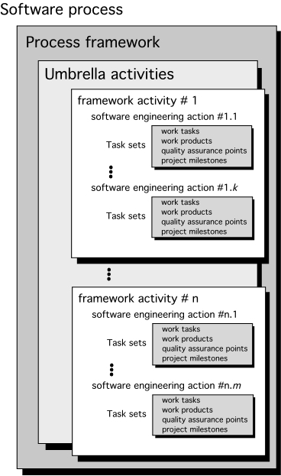
Generic Process Model

Slide 36
Task Set
A task set defines the actual work to be done to accomplish the objectives of a software engineering action.
  A list of the task to be accomplished
  A list of the work products to be produced
  A list of the quality assurance filters to be applied

Slide 37
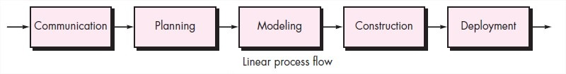
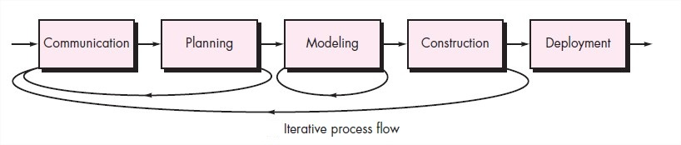
Process Flow
Describes how the framework activities and the actions and tasks that occur within each framework activity are organized with respect to sequence and time.

Slide 38
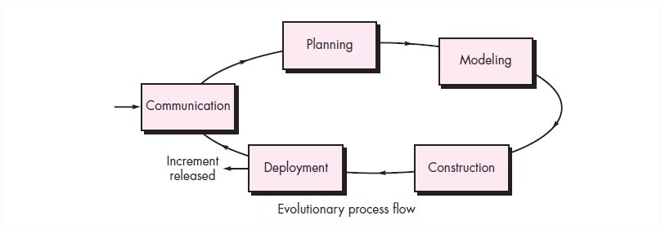
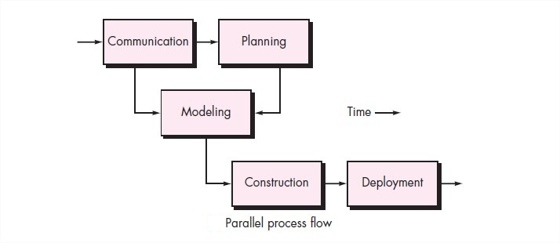
Process Flow

Slide 39
Waterfall Model
The first formal description of waterfall model is cited in 1970 by Winston W.Royce.
The Waterfall Model was the first Process Model to be introduced. It is also referred to as a linear-sequential life cycle model.
It is very simple to understand and use.
The Waterfall model is the earliest SDLC approach that was used for software development.
The waterfall Model illustrates the software development process in a linear sequential flow.
This means that any phase in the development process begins only if the previous phase is complete.
In this waterfall model, the phases do not overlap

Slide 40
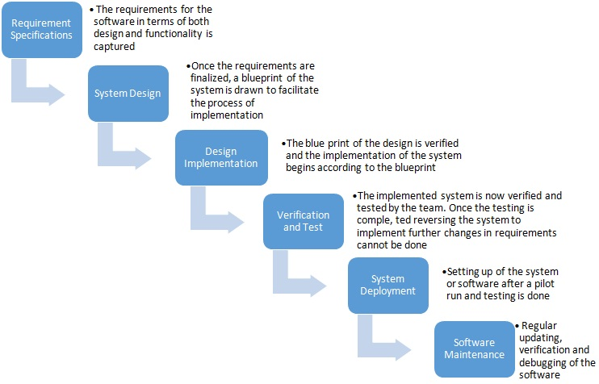
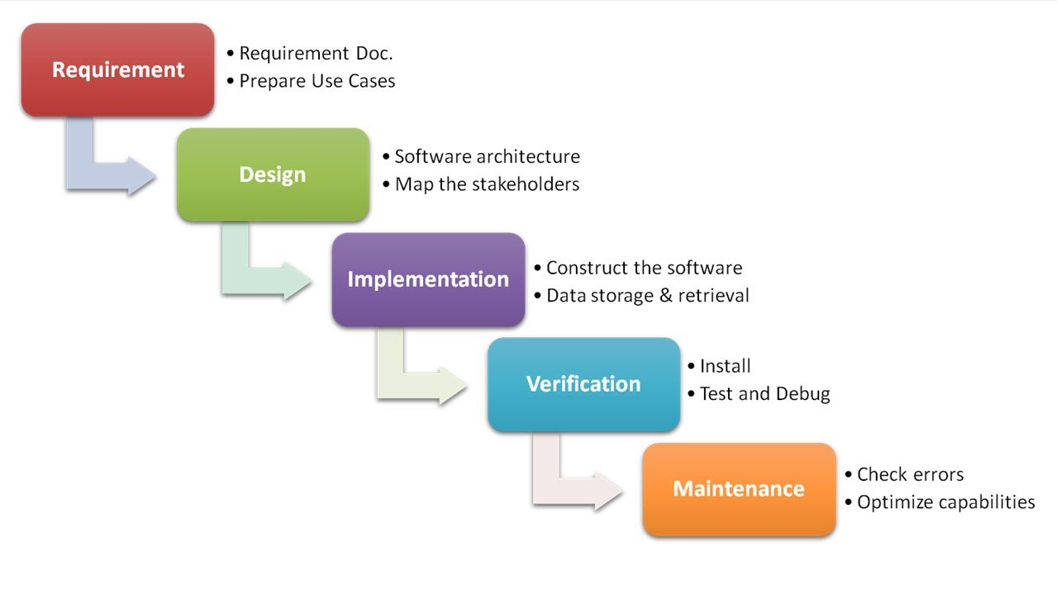
The Waterfall Model

Slide 41
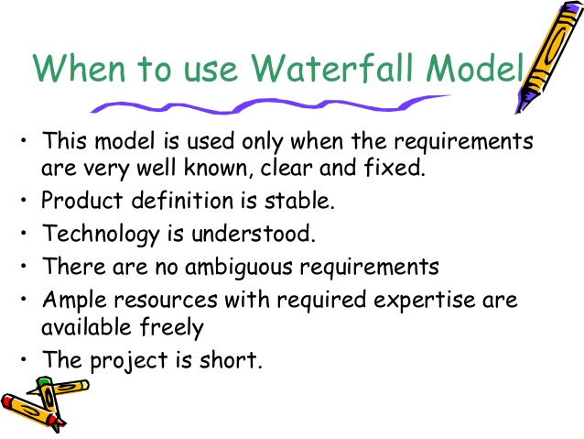
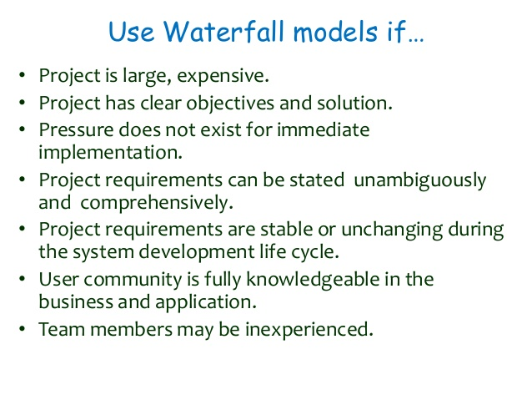

Slide 42
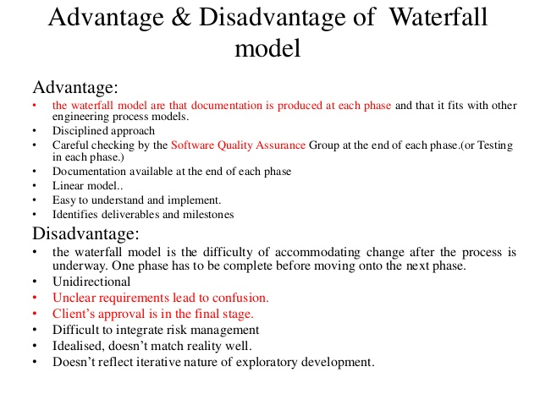

Slide 43
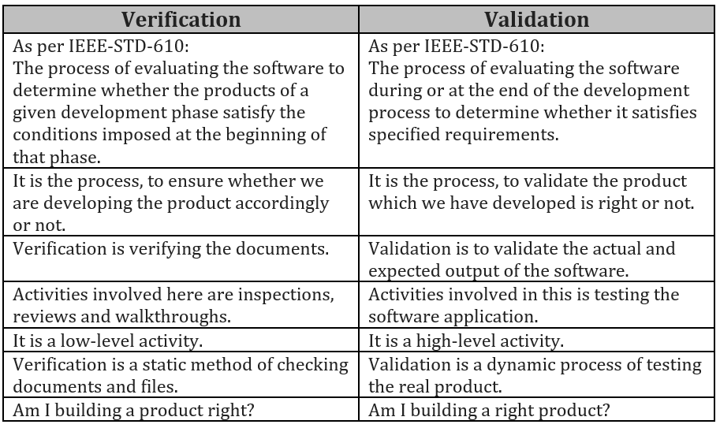

Slide 44
Incremental Model
Incremental Model is a process of software development where requirements are broken down into multiple standalone modules of software development cycle.
Incremental development is done in steps from analysis, design, implementation, testing/verification, and maintenance.

Slide 45
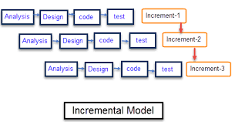
Incremental Model
It is also Known as Multi Water fall Model.

Slide 46
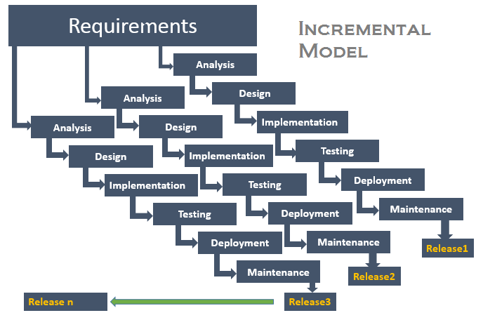
Incremental Model

Slide 47
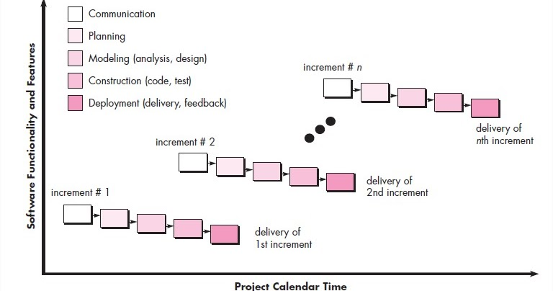
Incremental Model

Slide 48
Incremental Model
Incremental model is used when enough staffing is unavailable.
Each iteration passes through the requirements, design, coding and testing phases.
Each subsequent release of the system adds function to the previous release until all designed functionality has been implemented.
The system is put into production when the first increment is delivered.
Once the core product is analyzed by the client, there is plan development for the next increment.

Slide 49
When to use Incremental models?
Requirements of the system are clearly understood
When demand for an early release of a product arises
When software engineering team are not very well skilled or trained
When high-risk features and goals are involved

Slide 50
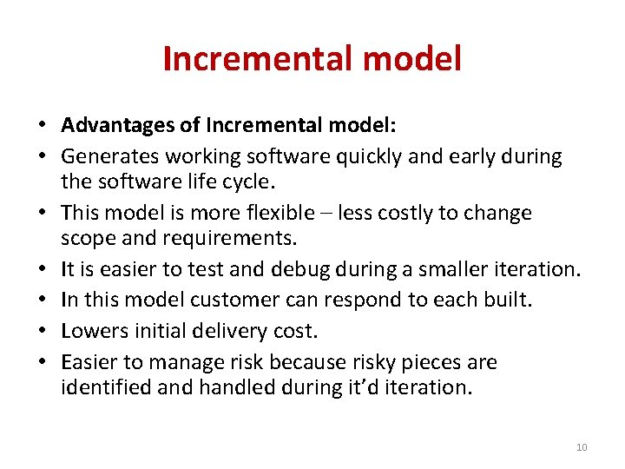

Slide 51
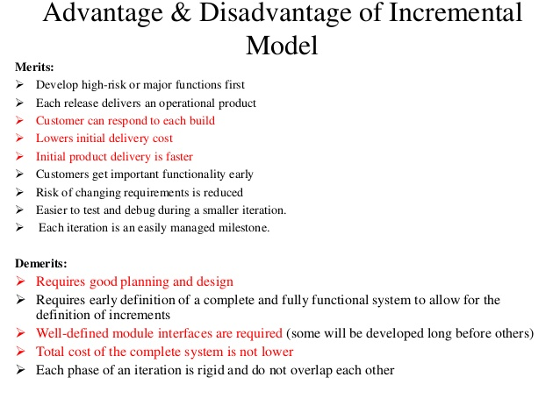

Slide 52
Evolutionary Models
The word Evolutionary derived from the word “Evolution”.
It is a combination of iterative and incremental apporach for developing a good software.
Evolutionary process models are Iterative (An iterative process is a process for calculating a desired results by means of a repeated cycle of operations) and incremental type models.
They allow to develop more complete versions of the software.

Slide 53
Evolutionary Process Models
1. Prototyping Model
2. Spiral Model
3. Concurrent Development Model

Slide 54
Prototyping Model
The Prototyping Model is one of the most popularly used Software Delvelopment Life Cycle Models (SDLC models)
The Prototyping Model should be used when the requirements of the product are not clearly understood.
It can also be used if requirements are changing quickly.
Prototyping model also supports risk handling, but the risks must be identified before the start of the development work of the project.
But in real life project risk may occur after the development work starts.

Slide 55
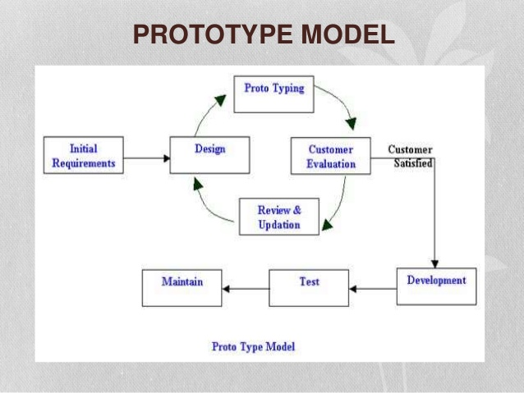
Prototyping Model
This model is used when the customers do not know the exact project requirements.
A prototype of the end product is first developed, tested and refined as per the customer feedback.

Slide 56
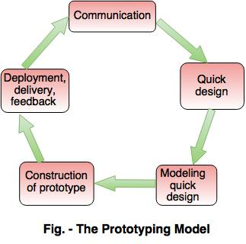

Slide 57
Prototyping Model
1. Communication
In this phase, developer and customer meet and discuss the overall objectives of the software.
2. Quick design
Quick design is implemented when requirements are known.
It includes only the important aspects like input and output format of the software.
It focuses on those aspects which are visible to the user rather than the detailed plan.
It helps to construct a prototype.

Slide 58
Prototyping Model
3. Modeling quick design
This phase gives the clear idea about the development of software because the software is now built.
It allows the developer to better understand the exact requirements.
4. Construction of prototype
The prototype is evaluated by the customer itself.
5. Deployment, delivery, feedback
If the user is not satisfied with current prototype then it refines according to the requirements of the user.
The process of refining the prototype is repeated until all the requirements of users are met.
When the users are satisfied with the developed prototype then the system is developed on the basis of final prototype.

Slide 59
Prototyping Model
Advantages
Errors are detected much earlier.
Ensures a greater level of customer satisfaction and comfort.
It identifies the missing functionality easily.
It also identifies the confusing or difficult functions.
Disadvantages
The client involvement is more and it is not always considered by the developer.
It is a slow process because it takes more time for development.
Many changes can disturb the rhythm of the development team.

Slide 60
Prototype Focus
Problem
Requirements are unclear
Build Prototype
Customer Gives Feedback
Requirements Become Clear
Develop Final Software
Prototype answers one question:
"What exactly does the customer want?"

Slide 61
Spiral Focus
Problem
High Risk
Identify Risk
Reduce Risk
Develop Software
REPEAT
Prototype answers one question:
"What can go wrong, and how do we prevent it?“
"Developer, what risks may affect this project?"

Slide 62
Types of Risk in Spiral
1. Technical Risk
Meaning
Technology may fail.
Example
Your company decides to use AI-based Face Recognitionfor banking login.
Question
Will it work perfectly?
Nobody knows.
Maybe Recognition is slow.
Wrong person gets authenticated.
Camera doesn't work.
This uncertainty is called
Technical Risk.

Slide 63
2. Cost Risk
Example
Estimated Budget
₹10 Crores.
After six months,
Need more servers.
Need more developers.
Budget becomes
₹16 Crores.
Company loses money.
This is
Cost Risk.

Slide 64
3. Schedule Risk
Example
Software should finish in
12 months.
But
Developers resign.
Requirements change.
Testing takes longer.
Project finishes in
18 months.
Customer becomes unhappy.
This is
Schedule Risk.

Slide 65
4. Requirement Risk
Prototype
Requirements are NOT KNOWN.
Requirement Risk
Requirements are known BUT Customer may still changethem.
Example
Initially Customer wantsPassword Login.
Later
Customer wants Face Recognition.
Requirement changed.
This is Requirement Risk.

Slide 66
5. Security Risk
Example
Internet Banking.
Questions
Can hackers steal money?
Can hackers access passwords?
Can database leak?
These are
Security Risks.

Slide 67
Spiral Model
Barry Boehm.B introduced Sprial Model in 1986.
Spiral model is one of the most important Software Development Life Cycle model, which provides support for risk handling.
In its diagrammatic representation, it looks like a spiral with many loops.
Each loop of the spiral is called a phase of the software development process.
This model is much more flexible compared to other SDLC models.

Slide 68
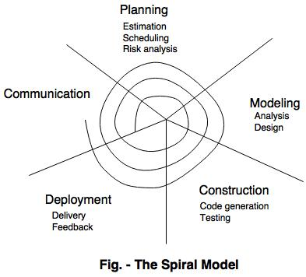

Slide 69
Spiral Model
    Communication – Gather Requirements from Customers
    Planning – Plan to be followed will be created. It describes the technical task to be conducted, risk ,required resources, work schedule etc.,
    Modeling – A model will be created to better understand the requirements
    Construction – Code generated and tested
    Deployment - Complete or partial complete version of software is given to the customer to evaluate and they give feed back based on the evaluation

Slide 70
Spiral Model
Advantages:
It reduces high amount of risk.
It is good for large and critical projects.
It gives strong approval and documentation control.
In spiral model, the software is produced early in the life cycle process.
Disadvantages:
It can be costly to develop a software model.
It is not used for small projects.

Slide 72
Concurrent Development Model
The concurrent development model is called as concurrent model.
The communication activity has completed in the first iteration and exits in the awaiting changes state.
The modeling activity completed its initial communication and then go to the underdevelopment state.
If the customer specifies the change in the requirement, then the modeling activity moves from the under development state into the awaiting change state.
The concurrent process model activities moving from one state to another state.

Slide 73
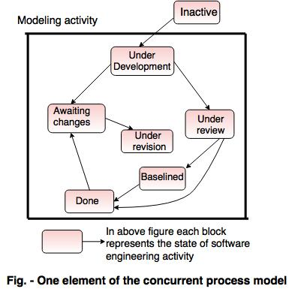
Concurrent Development Model

Slide 74
Advantages of the concurrent development model
This model is applicable to all types of software development processes.
It is easy for understanding and use.
It gives immediate feedback from testing.
It provides an accurate picture of the current state of a project.
Disadvantages of the concurrent development model
It needs better communication between the team members. This may not be achieved all the time.
It requires to remember the status of the different activities.

Slide 75
Requirement Engineering
Requirements Engineering (RE) refers to the process of defining, documenting, and maintaining requirements in the engineering design process.
Requirement Engineering Process
It is a four-step process, which includes -
Feasibility Study
Requirement Elicitation and Analysis
Software Requirement Specification
Software Requirement Validation

Slide 76
Requirement Engineering
Requirements Engineering (RE) refers to the process of defining, documenting, and maintaining requirements in the engineering design process.
Requirement Engineering Process
It is a four-step process, which includes -
Feasibility Study
Requirement Elicitation and Analysis
Software Requirement Specification
Software Requirement Validation

Slide 77
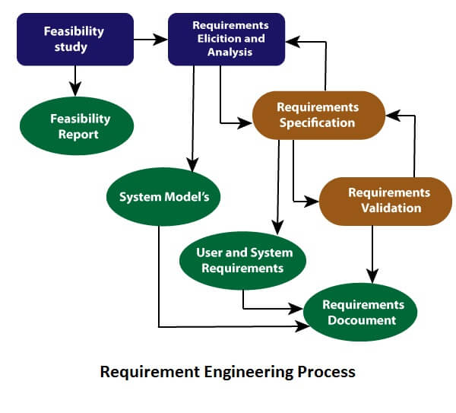

Slide 78
Feasibility Study
The objective behind the feasibility study is to create the reasons for developing the software that is acceptable to users, flexible to change and conformable to established standards.
Types of Feasibility:
Technical Feasibility: evaluates the current technologies, which are needed to accomplish customer requirements within the time and budget.
Operational Feasibility: assesses the range in which the required software performs a series of levels to solve business problems and customer requirements.
Economic Feasibility: Economic feasibility decides whether the necessary software can generate financial profits for an organization.

Slide 79
Requirement Elicitation and Analysis
This is also known as the gathering of requirements. Here, requirements are identified with the help of customers and existing systems processes, if available.
Analysis of requirements starts with requirement elicitation.
The requirements are analyzed to identify inconsistencies, defects, omission, etc.

Slide 80
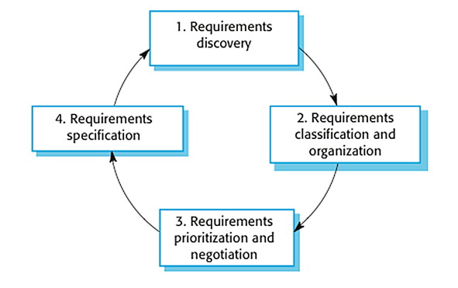
Requirement Elicitation and Analysis

Slide 81
Software Requirements
Broadly software requirements should be categorized in two categories:
Functional Requirements
Non Functional Requirements

Slide 82
Functional Requirements
Requirements, which are related to functional aspect of software fall into this category.
They define functions and functionality within and from the software system.
Examples -
Search option given to user to search from various invoices.
User should be able to mail any report to management.
Users can be divided into groups and groups can be given separate rights.
Should comply business rules and administrative functions.
Software is developed keeping downward compatibility intact.

Slide 83
Non-Functional Requirements
Requirements, which are not related to functional aspect of software, fall into this category. They are implicit or expected characteristics of software, which users make assumption of.
Non-functional requirements include -
  Security
  Logging
  Storage
  Configuration
  Performance
  Cost
  Interoperability
  Flexibility
  Disaster recovery
  Accessibility

Slide 84
Requirement Elicitation and Analysis
Requirement Elicitation Techniques
Interviews
Surveys
Questionnaires
Task analysis
Domain Analysis
Brainstorming
Prototyping
Observation

Slide 85
Requirements Analysis
Requirements analysis or requirements engineering is a process used to determine the needs and expectations of a new product.
It involves frequent communication with the stakeholders and end-users of the product to define expectations, resolve conflicts, and document all the key requirements.

Slide 86
Requirements Analysis Process
A requirements analysis process involves the following steps:
  Identify Key Stakeholders and End-Users
  Capture Requirements
  Categorize Requirements
  Interpret and Record Requirements
  Sign off

Slide 87
Requirements Analysis Process
Identify Key Stakeholders and End-Users:
The first step of the requirements analysis process is to identify key stakeholders who are the main sponsors of the project.
They will have the final say on what should be included in the scope of the project.
Next, identify the end-users of the product. Since the product is intended to satisfy their needs, their inputs are equally important.

Slide 88
Requirements Analysis Process
Capture Requirements:
Ask each of the stakeholders and end-users their requirements for the new product. some of the requirements analysis techniques are,
1. Hold One-on-One Interviews
2. Use Focus Groups
3. Utilize Use Cases
4. Build Prototypes

Slide 89
Requirements Analysis Process
Categorize Requirements:
Since requirements can be of various types, they should be grouped to avoid confusion. Requirements are usually divided into four categories:
Functional Requirements - Functions the product is required to perform.
Technical Requirements - Technical issues to be considered for the successful implementation of the product.
Transitional Requirements - Steps required to implement a new product smoothly.
Operational Requirements - Operations to be carried out in the backend for proper functioning of the product.

Slide 90
Requirements Analysis Process
Interpret and Record Requirements
Once the requirements are categorized, determine which requirements are actually achievable and document each one of them. some techniques to analyze and interpret requirements are,
Define Requirements Precisely
Prioritize Requirements
Carry Out an Impact Analysis
Resolve Conflicts
Analyze Feasibility

Slide 91
Requirements Analysis Process
Sign off
Once a final decision is made on the requirements, ensure that you get a signed agreement from the key stakeholders.
This is done to ensure that there are no changes or uncontrolled growth in the scope of the project.

Slide 92
Software Requirement Specification
Software requirement specification is a kind of document which is created by a software analyst after the requirements collected from the various sources.
The requirement received by the customer written in ordinary language.
It is the job of the analyst to write the requirement in technical language so that they can be understood and beneficial by the development team.

Slide 93
Software Requirement Specification
The models used at this stage include
Data Flow Diagrams: Data Flow Diagrams (DFDs) are used widely for modeling the requirements. DFD shows the flow of data through a system.
Data Dictionaries: Data Dictionaries are simply repositories to store information about all data items defined in DFDs.
Entity-Relationship Diagrams: Another tool for requirement specification is the entity-relationship diagram, often called an "E-R diagram."
It is a detailed logical representation of the data for the organization and uses three main constructs i.e. data entities, relationships, and their associated attributes.

Slide 94
Software Requirement Validation
After requirement specifications developed, the requirements discussed in this document are validated.
Requirements can be the check against the following conditions -
If they can practically implement
If they are correct and as per the functionality and specially of software
If there are any ambiguities
If they are full
If they can describe

Slide 95
Software Requirement Validation
Requirements Validation Techniques
Requirements reviews/inspections: systematic manual analysis of the requirements.
Prototyping: Using an executable model of the system to check requirements.
Test-case generation: Developing tests for requirements to check testability.
Automated consistency analysis: checking for the consistency of structured requirements descriptions.

Slide 96
Software Requirement Management
Requirement management is the process of managing changing requirements during the requirements engineering process and system development.

Slide 97
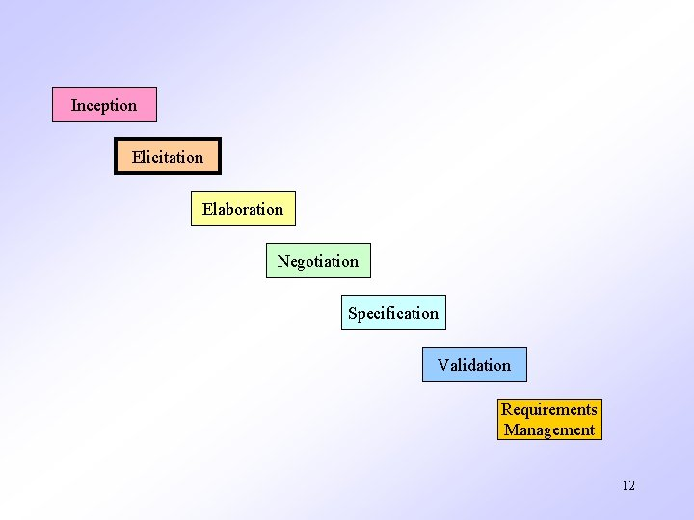
Requirement Engineering task

Slide 98
Requirement Engineering task
Inception —Establish a basic understanding of the problem and the nature of the solution.
Elicitation —Draw out the requirements from stakeholders.
Elaboration —Create an analysis model that represents information, functional, and behavioral aspects of the requirements.
Negotiation —Agree on a deliverable system that is realistic for developers and customers.
Specification —Describe the requirements formally or informally.
Validation—Review the requirement specification for errors, ambiguities, omissions, and conflicts.
Requirements management—Manage changing requirements.

Slide 99
Inception Task
The requirement engineer ask a set of question to establish
basic understanding of the problem
the people who want a solution
the nature of the solution that is desired, and
the effectiveness of preliminary communication and collaboration
between the customer and the developer
Through out the question , requirement engineer needs to
Identify the stakeholder
Recognize multiple view points
Work towards collaboration
Break the ice and initiate the communication

Slide 100
Elicitation task
Ask the customer, the users and others
what the objectives for the system or product are,
what is to be accomplished,
how the system or product fits into the needs of the business.
How the system or product to be used on day to day basis
Following are the problems that are encountered during elicitation
Problem of scope
Problem of understanding
Problems of volatility
To overcome the above problem , we must approach the requirement gathering in an organized way

Slide 101
Elaboration
The information obtained from the customer during inception and elicitation is expanded and refined it
Elaboration focuses on developing a refined technical model of software functions, features, and constraints
It is an analysis modeling task
  Use cases are developed
  Domain classes are identified
  State machine diagrams are used

Slide 102
Negotiation
Customers and users are ask for more than can be achieved ,given limited business resources
It is common for different customers or users to propose conflicting requirements
Reconciling the conflict through a process of negotiation
Customers, users and other stakeholders are asked
To rank/prioritizes the requirement
Assesses their cost
Risk
Addresses internal conflicts
So that requirements are eliminated, combined / modified both(Developer and customer) achieve some measure of satisfaction

Slide 103
Specification
Specification— “different things to different people” can be any one (or more) of the following:
A written document
A set of models
A formal mathematical model
A collection of user scenarios (use-cases)
A prototype

Slide 104
Validation
Product produced are assessed for quality during validation
Requirement validation examines the specification to ensure all the SW requirements stated clearly, that inconsistencies, omissions and error have been detected and corrected
The work product conform to the standards established for the process
Validation—a review mechanism that looks for
errors in content or interpretation
areas where clarification may be required
missing information
inconsistencies (a major problem when large products or systems are engineered)
conflicting or unrealistic (unachievable) requirements

Slide 105
Requirement management
It is a set of activities that help the project team identify, control and track the requirements and changes to requirement at any time as the project proceeds

Slide 106
Requirement Modeling
It is the process of Identifying a requirement the software solution must met in order to be successful.
It is divided into several stages
  Scenario Based Modeling
  Flow Oriented Modeling
  Class Based Modeling
  Behavioral Modeling

Slide 107
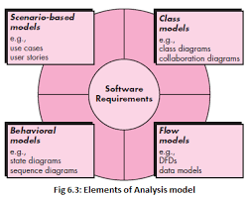

Slide 108
Scenario Based Modeling
Invented by Ivan Jacobson.
Modeling means producing Diagrams.
It can be drawn by UML (Unified Modeling Language)
Scenario based Modeling are represented in uses or Activity diagrams.
Use cases are simply an aid to defining what exists outside the system (actors) and what should be performed by the system.
It identifies the possible use cases for the system and produces the use case diagrams.
A scenario that describes a thread of usage for a system.
Actor represents roles of people or device in system functions.

Slide 109
Scenario Based Modeling
Use case:
Creating a Preliminary Use Case
What to write about,
How much to write about it,
How detailed to make your description and
How to organize the description?
Refining a Preliminary Use Case
Can the actor take some other action at this point?
Is it possible that the actor will encounter an error condition at some point? If so, what?
Is it possible that the actor will encounter some other behavior at some point? If so, what?
Writing a Formal Use Case

Slide 110
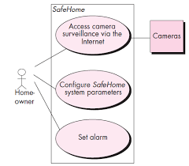
Preliminary use case diagram for safe home

Slide 111
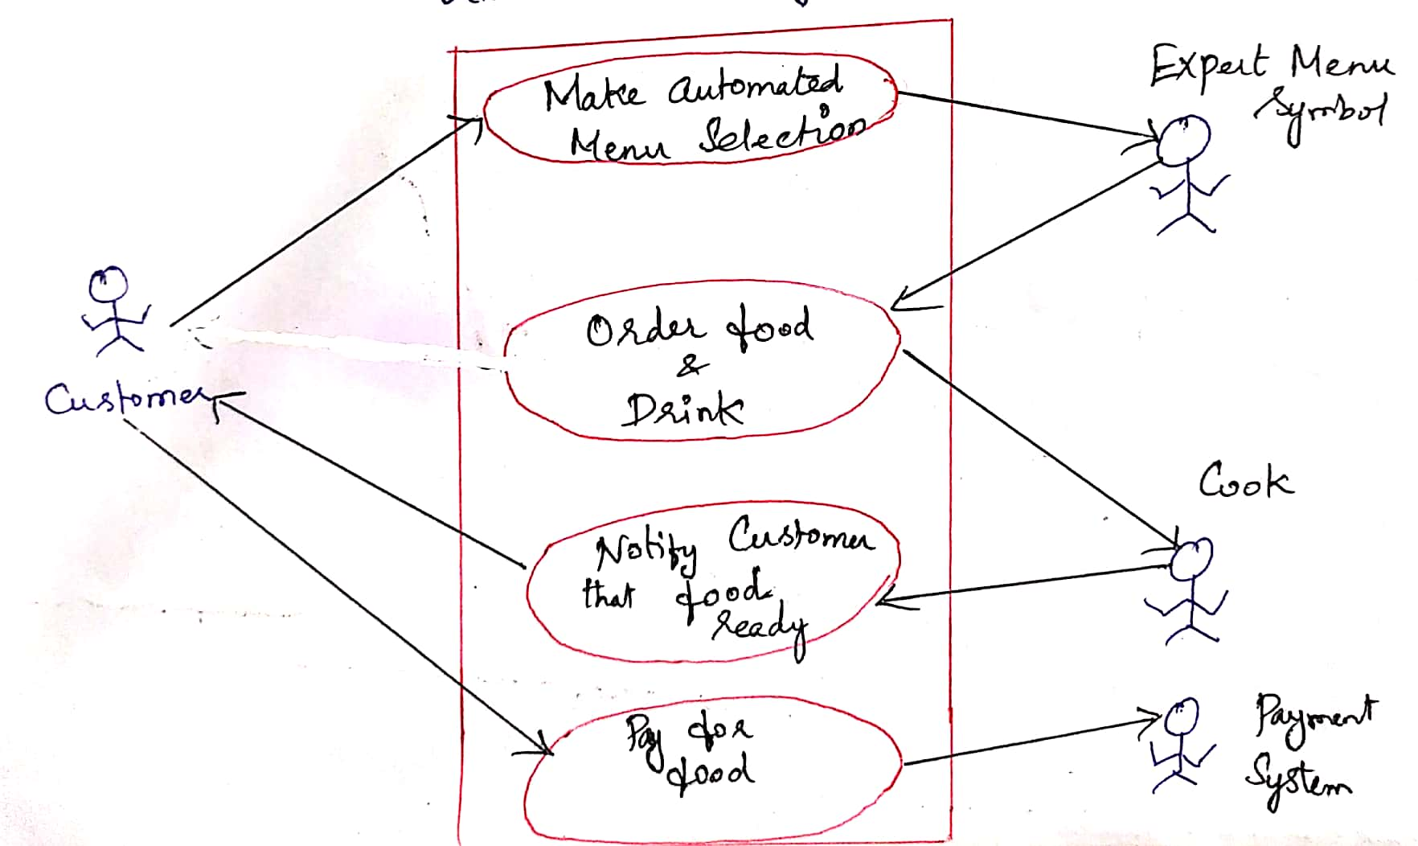
Usecase Diagram Food ordering

Slide 112
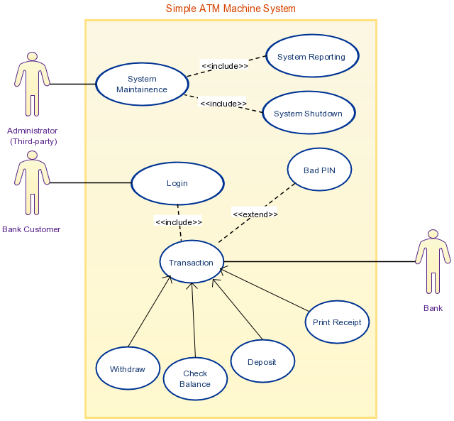

Slide 113
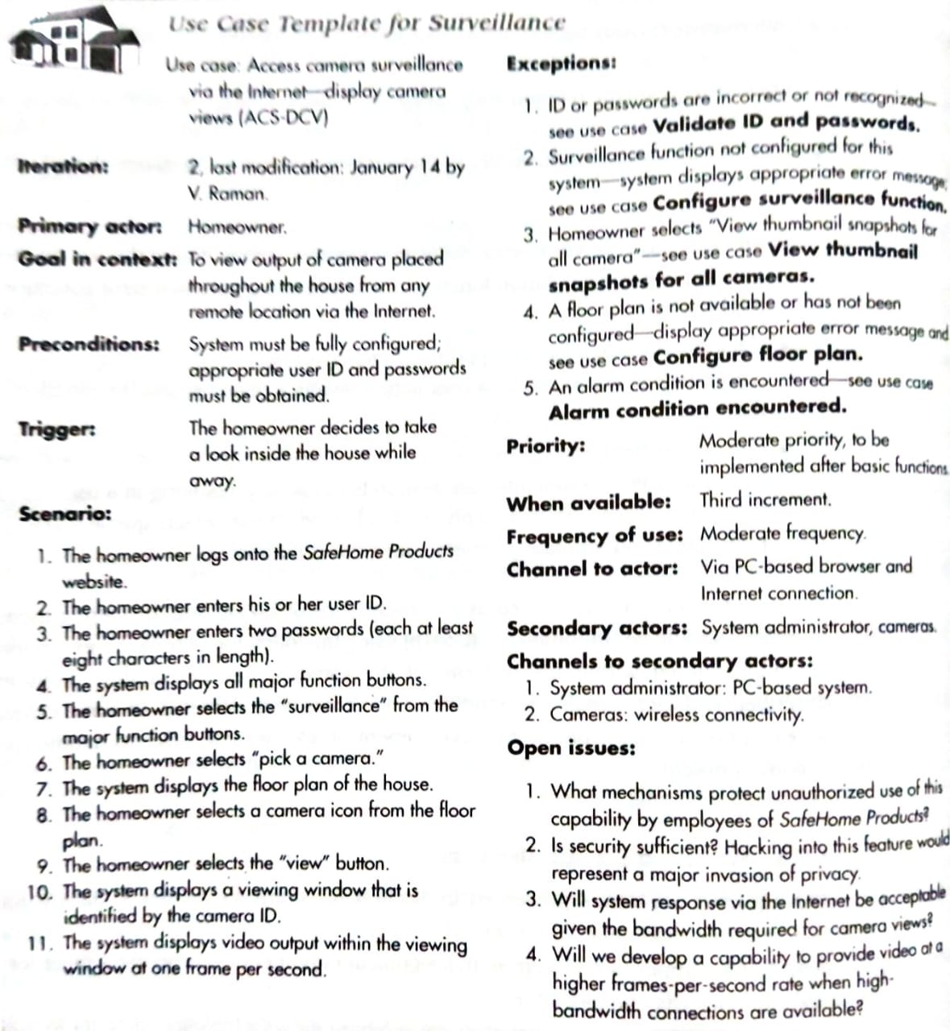
Writing a Formal Use case

Slide 114
Scenario Based Modeling
Activity Diagram
Graphical representation of the flow of interaction within a specific scenario
Rounded rectangles to imply a specific system function,
Arrows to represent flow through the system,
Decision diamonds to depict a branching decision and
Solid horizontal lines to indicate that parallel activities are occurring

Slide 115
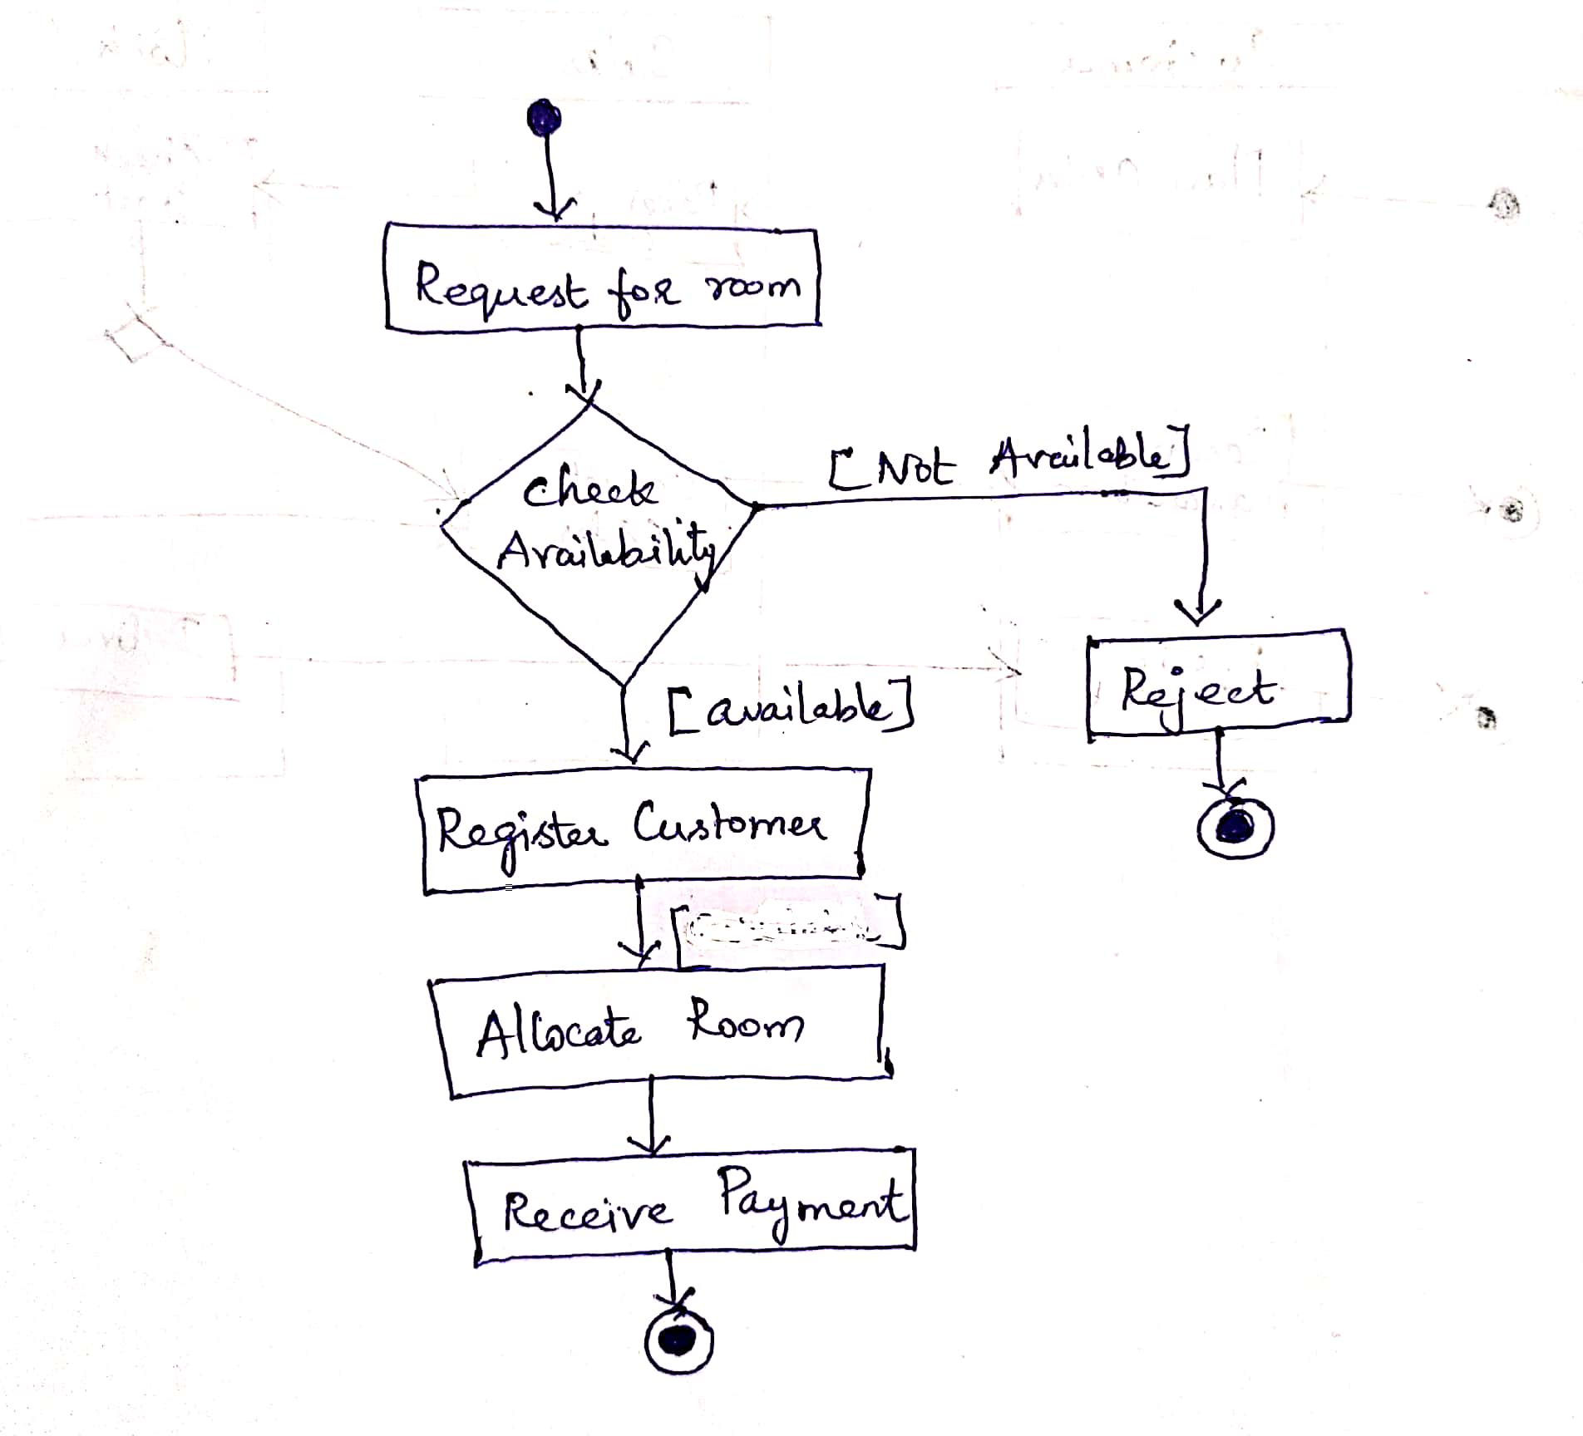
Activity Diagram Room Booking

Slide 116
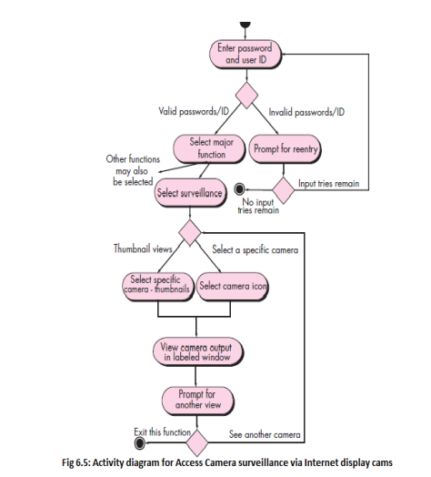
Activity Diagram

Slide 117
Scenario Based Modeling
Swimlane Diagrams:
Represent the flow of activities described by the use case
At the same time indicate which actor or analysis class has responsibility for the action described by an activity rectangle.
Responsibilities are represented as parallel segments that divide the diagram vertically

Slide 118
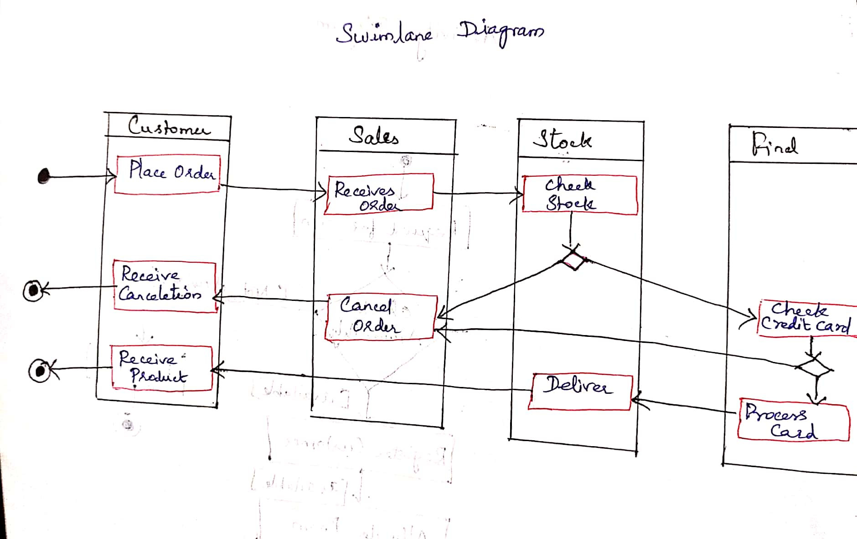
Swimlane Diagram

Slide 119
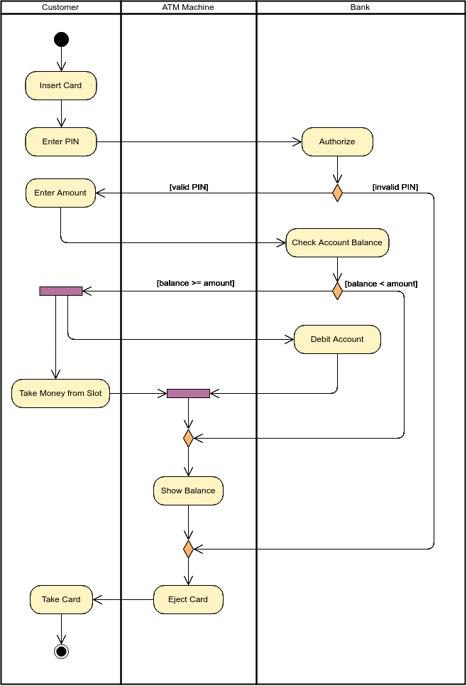

Slide 120
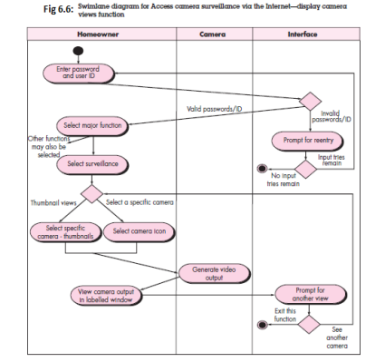
Swimlane Diagrams

Slide 121
Class Based Modeling
Class-based modeling takes the use case and extracts from it the classes, attributes, and operations the application will use. Like all modeling stages, the end result of class-based modeling is most often a diagram or series of diagrams, most frequently created using UML.
Class-based modeling represents the objects that the system will manipulate, the operations (also called methods or services) that will be applied to the objects to effect the manipulation, relationships (some hierarchical) between the objects, and the collaborations that occur between the classes that are defined.
The elements of a class-based model include classes and objects, attributes, operations, class responsibility-collaborator (CRC) models, collaboration diagrams, and packages.

Slide 123
Class Based Modeling
Identifying Analysis Classes
Specifying Attributes
Defining Operations
Class Responsibility Collaborator (CRC) Modeling
Associations and Dependencies
Analysis Packages

Slide 124
Identifying Analysis Classes
If you look around a room, there is a set of physical objects that can be easily identified,
classified, and defined (in terms of attributes and operations).
But when you“look around” the problem space of a software application, the classes (and objects) may be more difficult to comprehend.
We can begin to identify classes by examining the usage scenarios developed as part of the requirements model

Slide 125
Identifying Analysis Classes
Analysis classes manifest themselves in one of the following ways:
• External entities (e.g., other systems, devices, people) that produce or consume information to be used by a computer-based system.
• Things (e.g., reports, displays, letters, signals) that are part of the information domain for the problem.
• Occurrences or events (e.g., a property transfer or the completion of a series of robot movements) that occur within the context of system operation.
• Roles (e.g., manager, engineer, salesperson) played by people who interact with the system.
• Organizational units (e.g., division, group, team) that are relevant to an application.
• Places (e.g., manufacturing floor or loading dock) that establish the context of the problem and the overall function of the system.
• Structures (e.g., sensors, four-wheeled vehicles, or computers) that define a class of objects or related classes of objects.

Slide 126
Example.,
The SafeHome security function enables the homeowner to configure the security system when it is installed, monitors all sensors connected to the security system, and interacts with the homeowner through the Internet, a PC, or a control panel.

Slide 127
Specifying Attributes
Attributes are the set of Data Objects that fully define the class within the context of the problem.
Attributes describes the class that has been selected for inclusion in the requirement model.

Slide 128
Defining Operations
Operations define the behavior of an object. Although many different types of operations exist, they can generally be divided into four broad categories:
(1) operations that manipulate data in some way (e.g., adding, deleting, reformatting, selecting),
(2) operations that perform a computation,
(3) operations that inquire about the state of an object,
(4) operations that monitor an object for the occurrence of a controlling event.
These functions are accomplished by operating on attributes and/or associations

Slide 129
Defining Operations

Slide 130
Class-Responsibility-Collaborator (CRC)
Class-responsibility-collaborator (CRC) modeling [Wir90] provides a simple means for identifying and organizing the classes that are relevant to system or product requirements.
Used to identify and organize classes
A CRC model is really a collection of standard index cards that represent classes.
The cards are divided into three sections. Along the top of the card you write the name of the class.
In the body of the card you list the class responsibilities on the left and the collaborators on the right.

Slide 131
Class-Responsibility-Collaborator (CRC)

Slide 132
Class-Responsibility-Collaborator (CRC)

Slide 133
Class-Responsibility-Collaborator (CRC)

Slide 134
Class-Responsibility-Collaborator (CRC)
Responsibilities:
Five guidelines for allocating responsibilities to classes.
1. System intelligence should be distributed across classes to best address the needs of the problem.
2. Each responsibility should be stated as generally as possible.
3. Information and the behavior related to it should reside within the same class.
4. Information about one thing should be localized with a single class, not distributed across multiple classes.
5. Responsibilities should be shared among related classes, when appropriate.

Slide 135
Class-Responsibility-Collaborator (CRC)

Slide 144
Analysis Packages
An important part of analysis modeling is categorization. That is, various elements of the analysis model (e.g., use cases, analysis classes) are categorized in a manner that packages them as a grouping—called an analysis package—that is given a representative name.

Slide 145
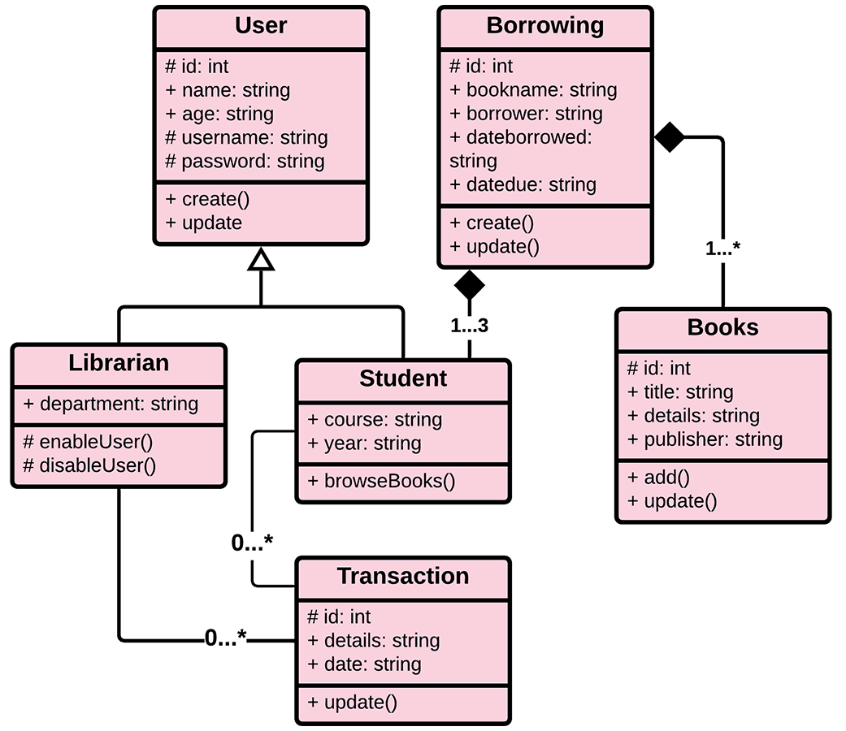
Library Management System

Slide 147
Collaboration Diagram
A collaboration diagram, also known as a communication diagram, is an illustration of the relationships and interactions among software objects in the Unified Modeling Language(UML).
The four major components of a collaboration diagram are:
  Objects- Objects are shown as rectangles with naming labels inside.
  Actors- Actors are instances that invoke the interaction in the diagram.
  Links- Links connect objects with actors and are depicted using a solid line between two elements.
  Messages- Messages between objects are shown as a labeled arrow placed near a link.

Slide 148
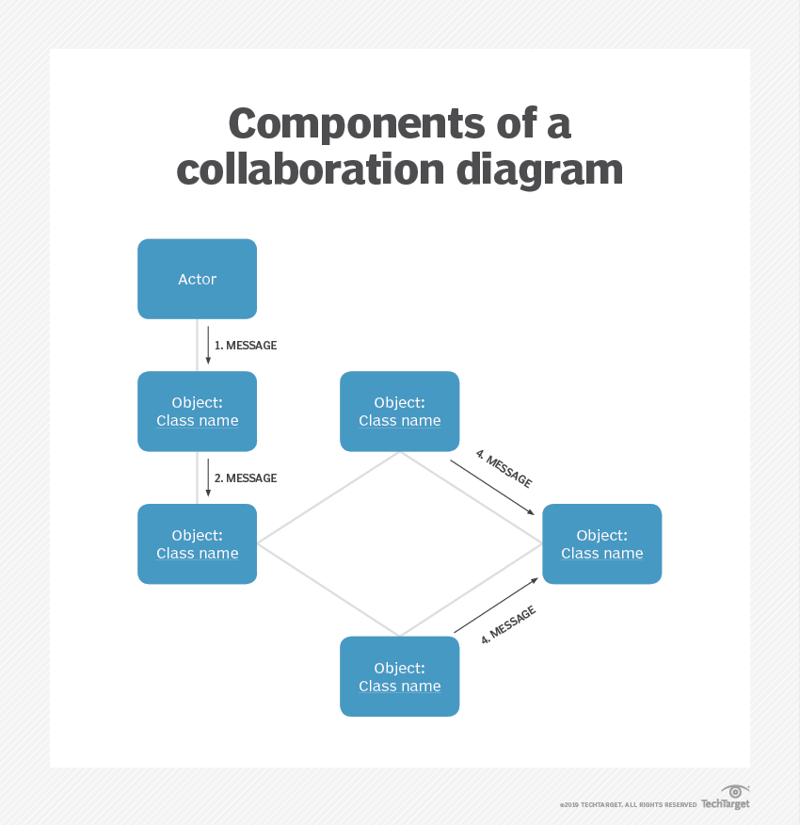

Slide 149
Collaboration Diagram for Issuing Book

Slide 150
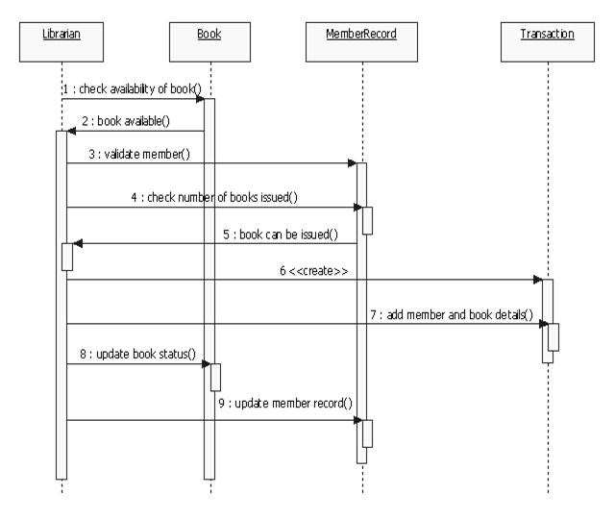
Sequence Diagram Example

Slide 151
Quality attributes
The attributes of design name as 'FURPS' are as follows:
Functionality:
It evaluates the feature set and capabilities of the program.
Usability:
It is accessed by considering the factors such as human factor, overall aesthetics, consistency and documentation.
Reliability:
It is evaluated by measuring parameters like frequency and security of failure, output result accuracy, the mean-time-to-failure(MTTF), recovery from failure and the program predictability.
Performance:
It is measured by considering processing speed, response time, resource consumption, throughput and efficiency.
Supportability:
It combines the ability to extend the program, adaptability, serviceability. These three term defines the maintainability.
Testability, compatibility and configurability are the terms using which a system can be easily installed and found the problem easily.
Supportability also consists of more attributes such as compatibility, extensibility, fault tolerance, modularity, reusability, robustness, security, portability, scalability.

Slide 152
Design Concepts
  The goal of the Good software design is to produce a model or representation that exhibits
  Firmness: A program should not have any bugs that inhibit its function.
  Commodity: A program should be suitable for the purposes for which it was intended.
  Delight: The experience of using the program should be pleasurable one.

Slide 153
Design Model

Slide 154
Design Concepts
A set of fundamental software design concepts has evolved over the history of Software Engineering.
Each provides the software designer with a foundation from which more sophisticated design methods can be applied. Each helps you answer the following questions:
What criteria can be used to partition software into individual components?
How is function or data structure detail separated from a conceptual representation of the software?
What uniform criteria define the technical quality of a software design?

Slide 155
Design Concepts
The set of fundamental software design concepts are as follows:
Abstraction
Architecture
Patterns
Modularity
Information hiding
Functional independence
Refinement
Refactoring
Design classes

Slide 156
Design Concepts
Abstraction—data, procedure, control
Architecture—the overall structure of the software
Patterns—”conveys the essence” of a proven design solution
Separation of concerns—any complex problem can be more easily handled if it is subdivided into pieces
Modularity—compartmentalization of data and function
Hiding—controlled interfaces
Functional independence—single-minded function and low coupling
Refinement—elaboration of detail for all abstractions
Aspects—a mechanism for understanding how global requirements affect design
Refactoring—a reorganization technique that simplifies the design
OO design concepts
Design Classes—provide design detail that will enable analysis classes to be implemented

Slide 157
Abstraction
Abstraction is the act of representing essential features without including the background details or explanations.
The abstraction is used to reduce complexity and allow efficient design and implementation of complex software systems.
Many levels of abstraction can be posed.
At the highest level of abstraction, a solution is stated in broad terms using the language of the problem environment.
At lower levels of abstraction, a more detailed description of the solution is provided.

Slide 158
Abstraction
Procedural Abstraction
A procedural abstraction refers to a sequence of instructions that have a specific and limited function. The name of a procedural abstraction implies the functions, but specific details are suppressed.
An example of a procedural abstraction would be the word open for a door. Open implies a long sequence of procedural steps.
e.g., walk to the door, reach out and grasp knob, turn knob and pull door, step away from moving door, etc.).

Slide 159
Abstraction
Data Abstraction
A data abstraction is a named collection of data that describes a data object.
In the context of the procedural abstraction open, we can define a data abstraction called door.
Like any data object, the data abstraction for door would encompass a set of attributes that describe the door (e.g., door type, swing direction, opening mechanism, weight, dimensions).
It follows that the procedural abstraction open would make use of information contained in the attributes of the data abstraction door.

Slide 160
Architecture
Software architecture alludes to “the overall structure of the software and the ways in which that structure provides conceptual integrity for a system”.
In its simplest form, architecture is the structure or organization of program components (modules), the manner in which these components interact, and the structure of data that are used by the components.
set of properties that should be specified as part of an architectural design:
  Structural properties
  Extra-functional properties
  Families of related systems

Slide 161
Architecture
Structural properties:
This aspect of the architectural design representation defines the components of a system (e.g., modules, objects, filters) and the manner in which those components are packaged and interact with one another.
Extra-functional properties:
The architectural design description should address
how the design architecture achieves requirements for performance, capacity, reliability, security, adaptability, and other system characteristics.
Families of related systems:
The architectural design should draw upon repeatable patterns that are commonly encountered in the design of families of similar systems.
In essence, the design should have the ability to reuse architectural building blocks.

Slide 162
Architecture
The architectural design can be represented using one or more of a number of different models.
Structural models: Represent architecture as an organized collection of program components.
Framework models: Increase the level of design abstraction by attempting to identify repeatable architectural design frameworks that are encountered in similar types of applications.
Dynamic models : Address the behavioral aspects of the program architecture, indicating how the structure or system configuration may change as a function of external events.
Process models :Focus on the design of the business or technical process that the system must accommodate.
Functional models : can be used to represent the functional hierarchy of a system.
A number of different architectural description languages (ADLs) have been developed to represent these models.

Slide 163
Patterns
Brad Appleton defines a design pattern in the following manner: “A pattern is a named nugget of insight which conveys the essence of a proven solution to a recurring problem within a certain context amidst competing concerns”.
Design pattern describes a design structure that solves a particular design problem within a specific context and amid “forces” that may have an impact
on the manner in which the pattern is applied and used.

Slide 164
Patterns
The intent of each design pattern is to provide a description that enables a designer to determine:
(1) whether the pattern is applicable to the current work,
(2) whether the pattern can be reused (hence, saving design time), and
(3) whether the pattern can serve as a guide for developing a similar, but functionally or structurally
different pattern.

Slide 165
Separation of Concerns
Separation of concerns is a design concept that suggests that any complex problem can be more easily handled if it is subdivided into pieces that can each be solved and/or optimized independently.
A concern is a feature or behavior that is specified as part of the requirements model for the software.
By separating concerns into smaller, and therefore more manageable pieces, a problem takes less effort and time to solve.
For two problems, p1 and p2, if the perceived complexity of p1 is greater than the perceived complexity of p2, it follows that the effort required to solve p1 is greater than the effort required to solve p2. As a general case, this result is intuitively obvious.

Slide 166
Separation of Concerns
It does not take more time to solve a difficult problem.
Separation of concerns is manifested in other related design concepts:
Modularity,
Aspects,
Functional Independence,
Refinement.

Slide 167
Modularity
Modularity is the most common manifestation of separation of concerns.
Software is divided into separately named and addressable components, sometimes called modules, that are integrated to satisfy problem requirements.
It has been stated that “modularity is the single attribute of software that allows a program to be intellectually manageable”

Slide 168
Modularity
However, as the number of modules grows, the effort (cost) associated with integrating the modules also grows.

Slide 169
Information Hiding
The principle of information hiding suggests that modules be “characterized by design decisions that hides from all others.”
In other words, modules should be specified and designed so that information contained within a module is inaccessible to other modules that have no need for such information.
The use of information hiding as a design criterion for modular systems provides the greatest benefits when modifications are required during testing and later during software maintenance.

Slide 170
Functional Independence
The concept of functional independence is a direct outgrowth of separation of concerns, modularity, and the concepts of abstraction and information hiding.
Functional independence is achieved by developing modules with “single minded” function and an “aversion” to excessive interaction with other modules.
Independence is assessed using two qualitative criteria:
  Cohesion
  Coupling

Slide 171
Cohesion
Cohesion is an indication of the relative functional strength of a module.
Cohesion is a natural extension of the information-hiding concept
A cohesive module performs a single task, requiring little interaction with other components in other parts of a program.
Stated simply, a cohesive module should (ideally) do just one thing.
Although you should always strive for high cohesion
(i.e., single-mindedness)

Slide 172
Coupling
Coupling is an indication of the relative interdependence among modules.
Coupling is an indication of interconnection among modules in a software structure.
Coupling depends on the interface complexity between modules, the point at which entry or reference is made to a module, and what data pass across the interface.
In software design, you should strive for the lowest possible coupling.

Slide 173
Refinement
Stepwise refinement is a top-down design strategy.
Refinement is actually a process of elaboration.
Abstraction and refinement are complementary concepts.
Abstraction enables you to specify procedure and data internally but suppress the need for “outsiders” to have knowledge of low-level details.
Refinement helps you to reveal low-level details as design progresses.

Slide 174
Aspects and Refactoring
Aspects
An aspect is a representation of a crosscutting concern.
A crosscutting concern is some characteristic of the system that applies across many different requirements.
Refactoring
“Refactoring is the process of changing a software system in such a way that it does not alter the external behavior of the code [design] yet improves its internal structure.”
An important design activity suggested for many agile methods, refactoring is a reorganization technique that simplifies the design (or code) of a component without changing its function or behavior.

Slide 175
Object-Oriented Design Concepts
The object-oriented (OO) paradigm is widely used in modern software engineering.
OO design concepts such as
  Classes and Objects
  Inheritance
  Message Passing
  Polymorphism
  are widely used.

Slide 176
Design Classes
A set of design classes that refine the analysis classes by providing design detail that will enable the classes to be implemented, and implement a software infrastructure that supports the business solution.
Five different types of design classes, each representing a different layer of the design architecture, can be developed:
User interface classes define all abstractions that are necessary for human computer interaction (HCI).
The design classes for the interface may be visual representations of the elements of the metaphor.

Slide 177
Design Classes
Business domain classes are often refinements of the analysis classes defined earlier. The classes identify the attributes and services (methods) that are required to implement some element of the business domain.
Process classes implement lower-level business abstractions required to fully manage the business domain classes.
Persistent classes represent data stores (e.g., a database) that will persist beyond the execution of the software.
System classes implement software management and control functions that enable the system to operate and communicate within its computing environment and with the outside world.

Slide 178
Design Classes
Four characteristics of a well-formed design class:
Complete and sufficient
Primitiveness
High cohesion
Low coupling

